Slide 1
Recycling
Battery
Car
Recycling of Lead-acid batteries are the environmental
success story of our time.
Basel Convention

Slide 2

Contents
Introduction
Lead poisonous
UAE Responsibility
Factory Responsibility
Conclusion
The results

Slide 3
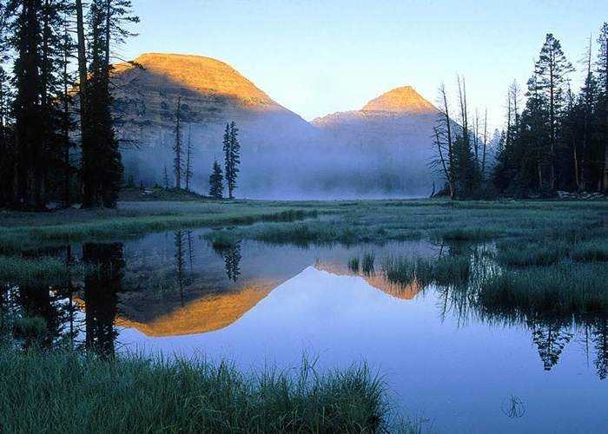
Factory Vision
To Keep Environment Clean

Slide 4

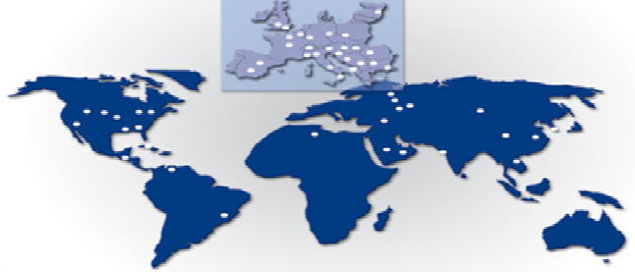
Similar Projects
Region | No
Europe | 32
America | 11
Asia | 9
Africa | 1

Slide 5
Lead Poisonous

Slide 6
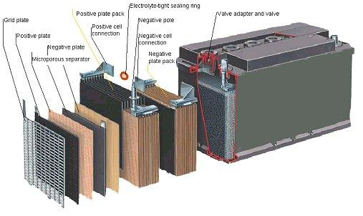
Battery Components
Electrolyte H2SO4 15-25 %
Lead sulphate PbSO4 25-35 %
Lead oxide PbOx 8-15 %
Grid metals 20-30 %
Polypropylene 4-7 %
Heavy plastic, paper, fiber, 2 -7 %

Slide 7
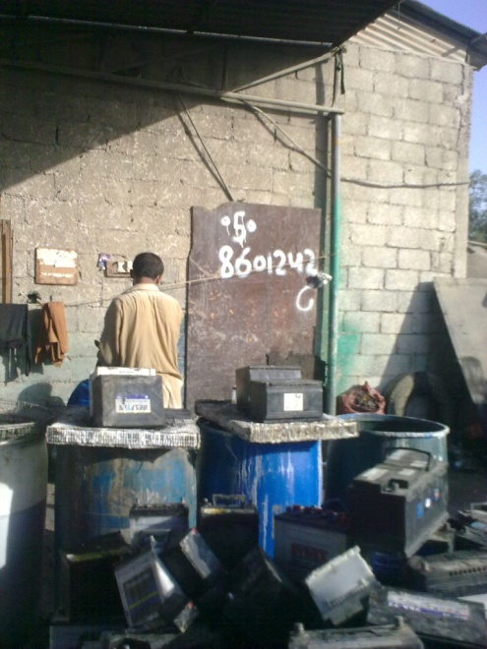
Collected batteries per year in UAE
Abu Dhabi emirate had over 784,000 cars at the end of 2011.
In 2011, the total number of vehicles registered in Dubai was 1,052,891. Out of this, more than 115,380 vehicles
Traffic congestion, the single biggest concern among Dubai's 1.44 million residents, The city has a car ownership rate of 541 cars per 1,000 population. If this trend continues, then by 2020, there will be 5.3 million registered cars in Dubai.
The total number of cars in UAE around 2.5 Millions

Slide 8
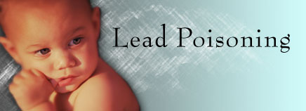
Why Is Lead Harmful?
Lead gets into a person's system, it is distributed throughout the body just like helpful minerals such as iron, calcium, and zinc.
And lead can cause harm wherever it lands in the body.
In the bloodstream, for example, it can damage red blood cells and limit their ability to carry oxygen to the organs and tissues that need it, thus causing anemia.
Most lead ends up in the bone, where it causes even more problems.

Slide 9
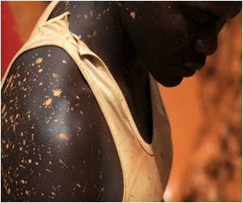
Effect of short - term lead poisoning
The short-term effects of lead poisoning include:
Acute fever,
Convulsions,
Loss of consciousness and blindness, with anemia,
Renal failure
Exposure to high levels of lead in a short period of time is called Acute toxicity.

Slide 10
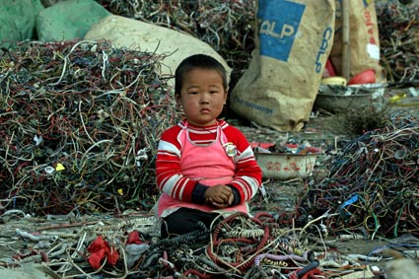
Effects of Long-Term Lead Poisoning
Decreased bone and muscle growth
Poor muscle coordination
Damage to the nervous system, kidneys, and/or hearing and brain damage.
Speech and language problems
Developmental delay
Seizures and unconsciousness (in cases of extremely high lead levels)
Exposure to small amounts of lead over a long period of time is called Chronic toxicity.

Slide 11
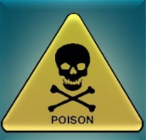
Signs of Lead Poisoning
Many kids with lead poisoning don't show any signs of being sick, so it's important to eliminate lead risks at home and to have young kids tested for lead exposure.
When kids do develop symptoms of lead poisoning, they usually appear as:
Irritability or behavioral problems (eating of no nutritious things such As dirt and paint chips)
Difficulty concentrating - headaches
Loss of appetite - weight loss
Sluggishness or fatigue - abdominal pain
Vomiting or nausea - constipation
Pallor (pale skin) from anemia - metallic taste in mouth
Muscle and joint weakness or pain - seizures

Slide 12
UAE Responsibility

Slide 13


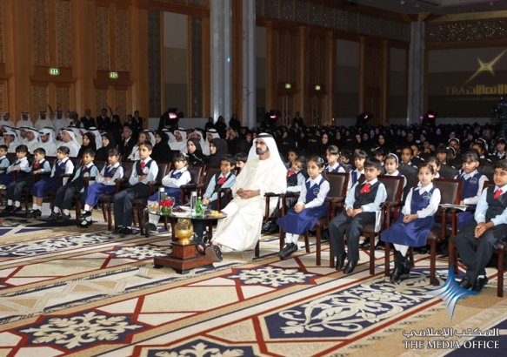
What about next generation???
Environmental Rights
Air Emissions and Ambient Air Quality
Energy Conservation
Wastewater and Ambient Water Quality
Water Conservation
Hazardous Materials Management
Waste Management
Noise
Contaminated Land and Remediation

Slide 14
Factory Responsibility

Slide 15
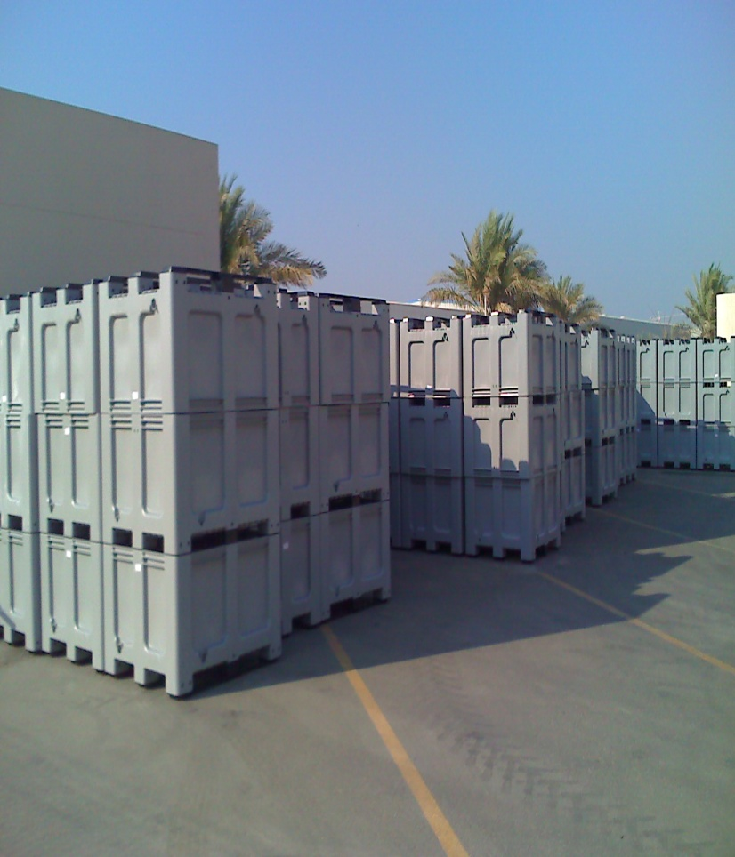
Pre-Recycling

Slide 16
Pre-recycling Environ. Control

Slide 17
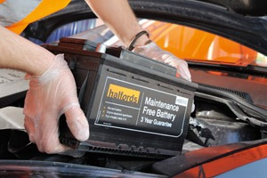
Pre-Recycling Steps
Used batteries must be
Collected,
Transported
Stored with proper care,
in order to avoid adverse health effects and environmental contamination.

Slide 18
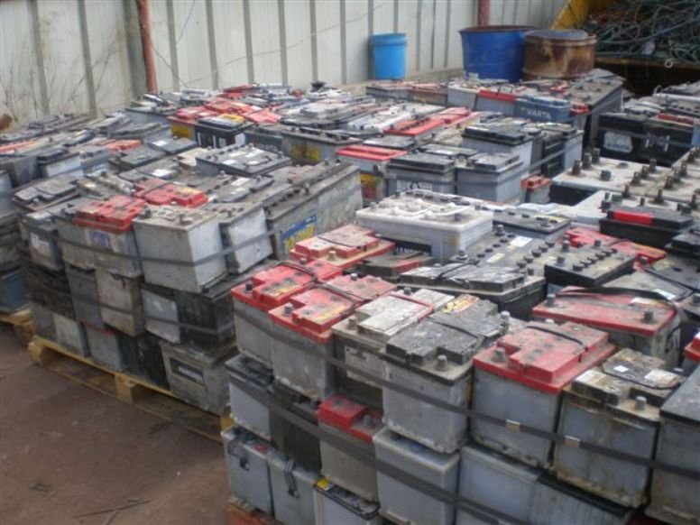
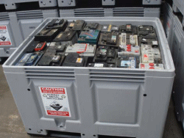
Acid drainage
Others
Safe Box
The drainage of this liquid may pose several threats to the human health and to the environment, the drainage at collection points it should be avoided;

Slide 19
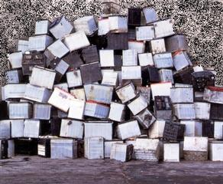
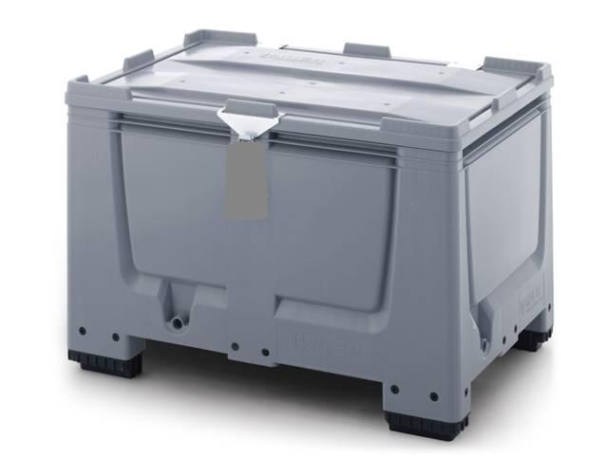
Rain
Others
Save Box
the storage facility must be sheltered from rain and other water sources,

Slide 20
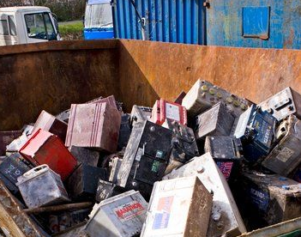
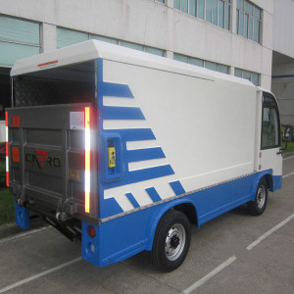
Transporting
Others
Collection truck
Used lead-acid batteries must be considered as hazardous wastes when transport is needed. drivers and auxiliaries should be trained and use PPE

Slide 21
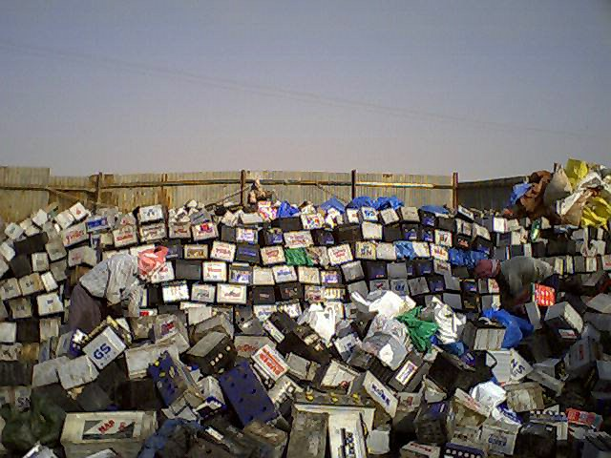
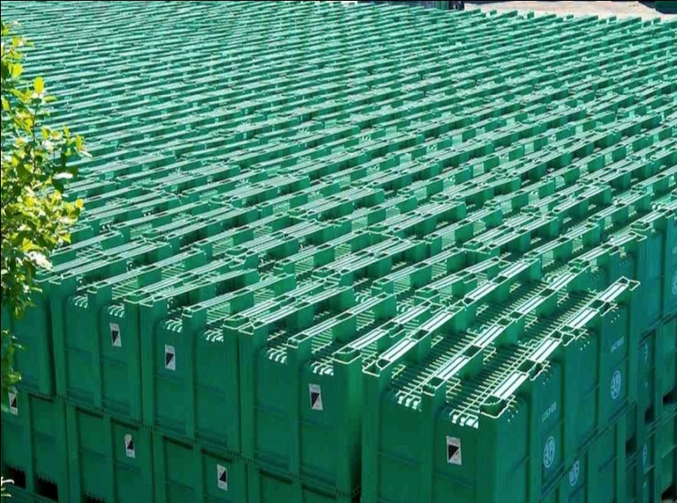
Stored in proper places
Others
Storing Boxes
the ideal place to store used lead-acid batteries is inside a acid-resistant container that may simply be sealed and used as the transport container as well minimizing the risk of an accidental spillage.

Slide 22

Recycling

Slide 23

Plant Specifications
Electrolyte Collection and Filtration Unit
Breaker and Separation Unit
Lead paste Desulphurization &Filtration
Sodium Sulphate Production Unit
Gaseous Effluents Scrubbing System Unit
Lead Smelting Unit
Lead Refinery and casting Unit

Slide 24
Process Description
Factory
CX Area
Smelting
Refinery
Casting
Gas Scrubber
Paste treat
Sulphate production
Electrolyte Collection
Lead
production
Plastic production

Slide 25


Environmental Monitoring
Control measures ensure that operational mistakes and accidents are decreased as much as possible,
In a modern lead recycling plant, the cost of pollution treatment, including effluents, smoke and dusts removal, and elimination of sulphur dioxide (SO2), amounts to 20-30% of the investment costs.

Slide 26
CX Area Environ. Control

Slide 27
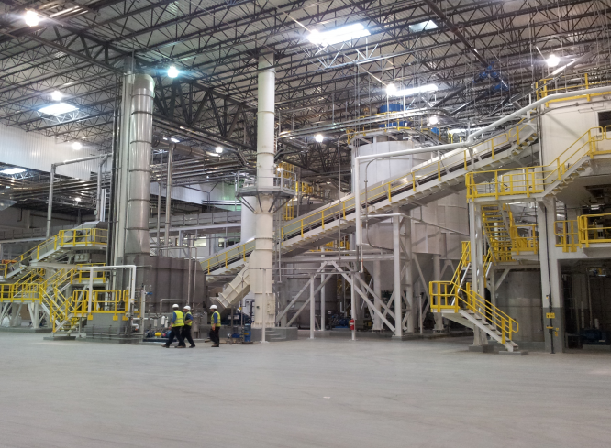
CX Area
Batteries breaking.
Components separation, and cleaning
Paste thickening.
Paste and sulphate solution filtration.
Sulphate solution evaporation.
Sodium sulphate crystallization.
Sodium sulphate centrifugation.
Sodium sulphate drying.

Slide 28
Separation and Treatment

Slide 29
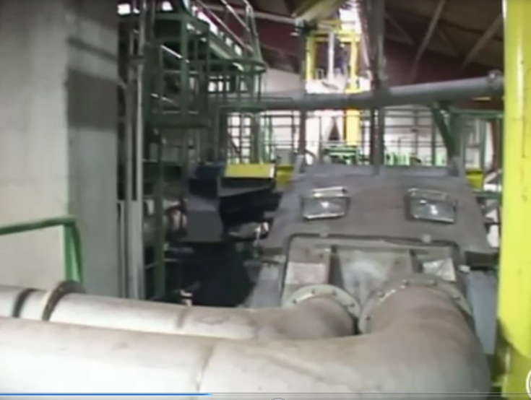
Liquid and solid
Liquid
plant washing water , necessary for floor, spills and equipments washing can be recovered into the process. no process liquid effluent will be released from the plant.
Solid
excluding the by-products of process (ebonite , separators and others) no other solid effluent is released at the CX area.

Slide 30
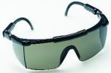


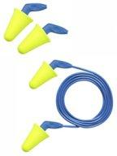
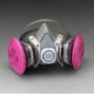
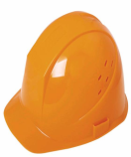




Personnel protective equipments in Factory
 | Locations |  |  |  |  |  |  |  |  | Others
1 | CX area | √ | √ | √ | √ | ----- | √ | √ | ----- | -----
 | Batteries Bunker | √ | √ | √ | √ | In case of handling Soda And Acid | √ | √ | In case of handling Soda And Acid
 | breaker | √ | √ | √ | √ |  | √ | √ |  | -----
 | Sulphate process | √ | √ | √ | √ |  | √ | √ |  | -----
2 | Inside factory gate | √ | √ |  |  | ----- | ----- | ----- | ----- | -----

Slide 31
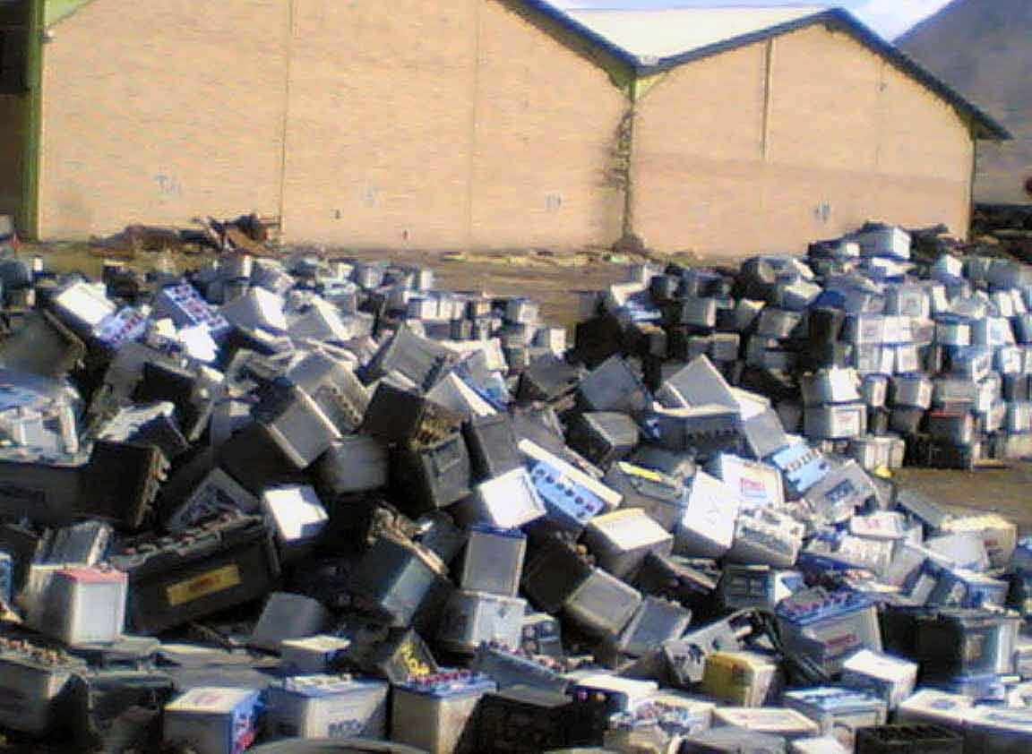
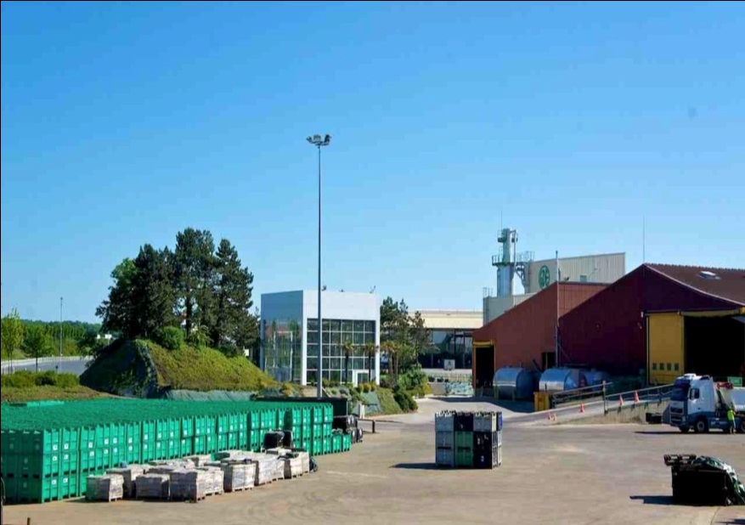
Factory
Others
factory

Slide 32
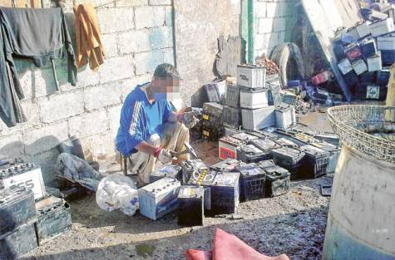
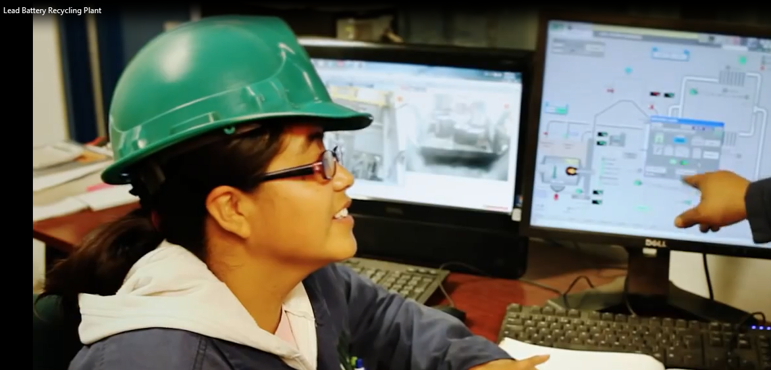
Process
Others
Factory process

Slide 33
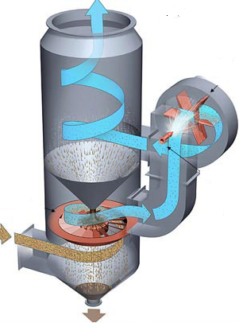
Wet Gas scrubber
Every source of pollutant gas effluents from:-
battery bunker
Battery breaking
Reactor
Conveyor and mill
For wet gas only.

Slide 34
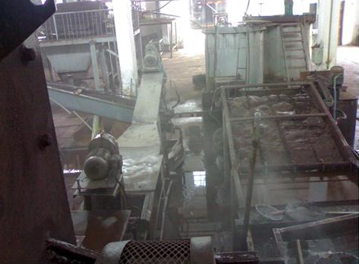
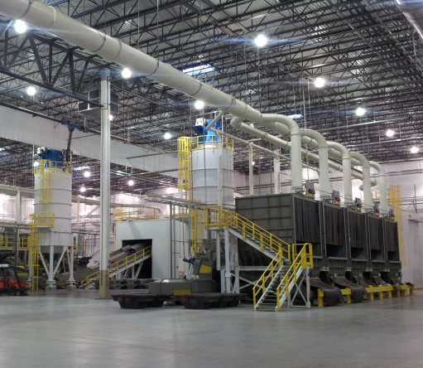
Unlicensed lead smelters
Others
Good process area
collectors must not sell their batteries to unlicensed lead smelters:
since unlicensed smelters are one of the main sources of lead contamination,

Slide 35
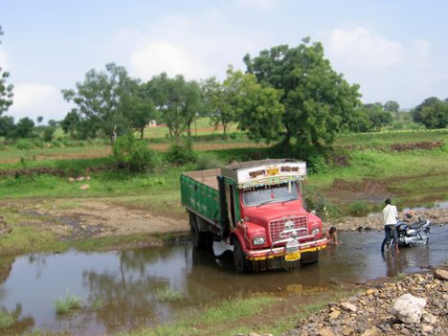
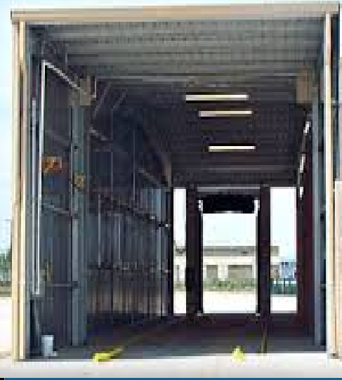
Truck wash
Others
truck wash

Slide 36
Smelting Area Environ. Control

Slide 37
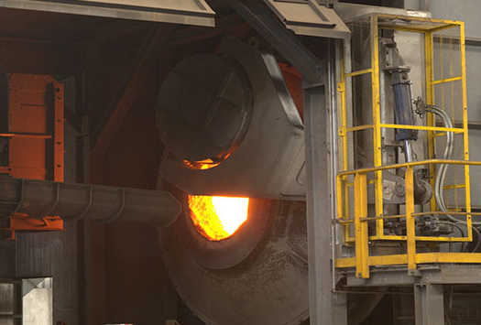
Smelting Area
Smelting involves the reduction of lead-bearing scrap into metallic lead in a furnace.
Lead and reagents are loaded in rotary furnace with the highest Possible mixing grade .
For small furnace loads and whenever be possible, it is advisable To mix the feed components (lead and reagents) before loading them Into the furnace.

Slide 38
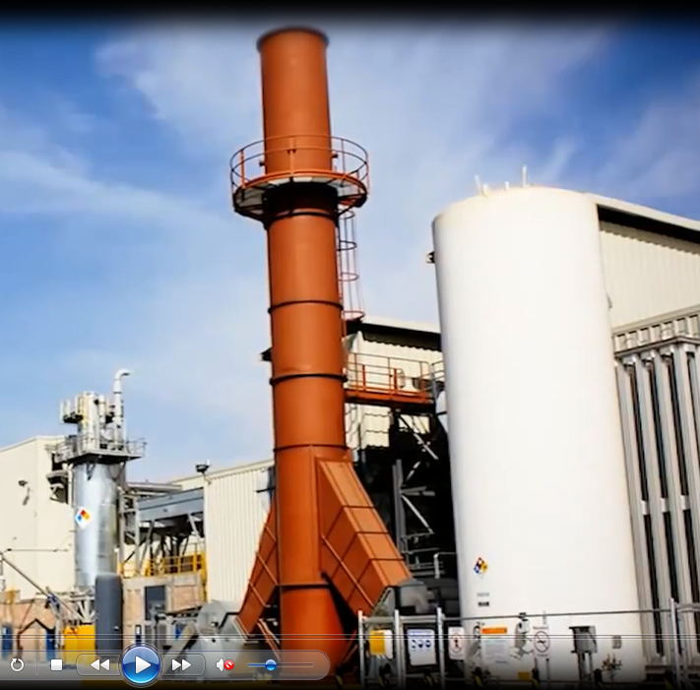
Gas scrubber
Every source of pollutant gas effluents from:-
Furnace
Kettles
Casting
Slag
For dry gas only
No. | Pollutant | Range | Unit
1 | Total dust | 5.0 | mg/ Nm³
2 | Lead | 0.5 | mg/Nm³
4 | Temperature | 40 - 50 | ⁰C

Slide 39
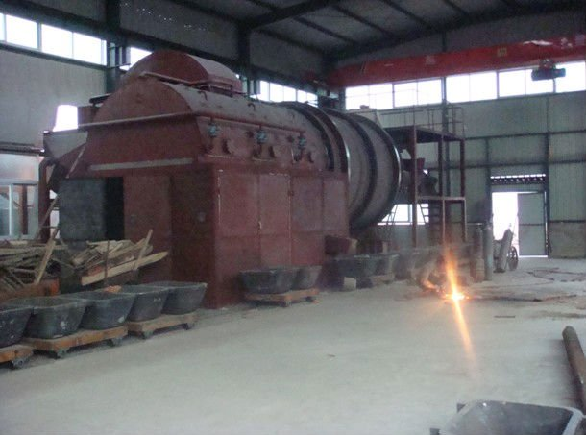
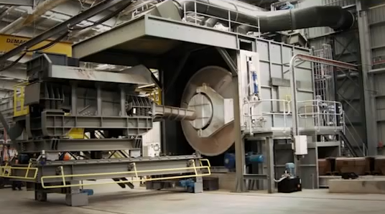
Ventilated Furnace
Others
Advanced Furnace

Slide 40
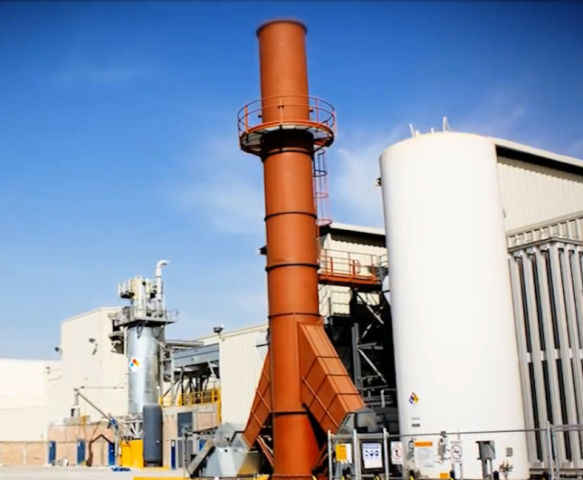
Gas scrubber
Flue gases from furnaces and air from ventilation systems are vented to cyclones, scrubbers, bag houses, etc. for particulate removal.
Flue dust must be removed from the separator (air pollution control equipment) and transported to storage, recycle streams, or to off-plant receivers.
Dust collection systems can be a significant source of lead exposure if not properly operated, cleaned, and maintained.

Slide 41
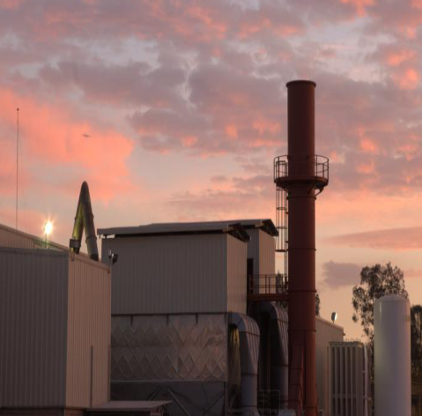
Air filter bag house
“Air Filter Bag House”
contains 100% polyester Non-woven fabric filter bags fitted in the bag holding cage.
The bag house is equipped with pulse jet type cleaning arrangement.
Pulsejet cleaning unit is designed for continuous operation that operates at appropriate pressure of compressed dry air.

Slide 42
Refinery Area Environ. Control

Slide 43
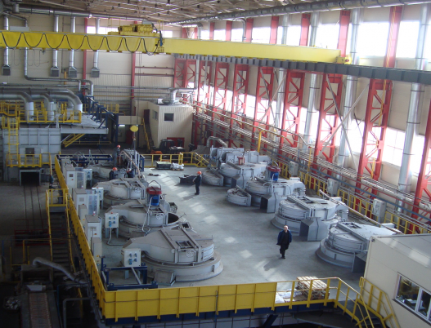
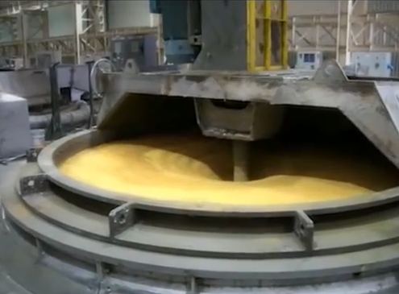
Refinery Area
The objective of the refining process is to remove almost all of:-
Copper (Cu)
Antimony (Sb)
Arsenic (As)
Tin (Sn)
since soft lead are not allowed to have more than 10g per ton of these metals.

Slide 44
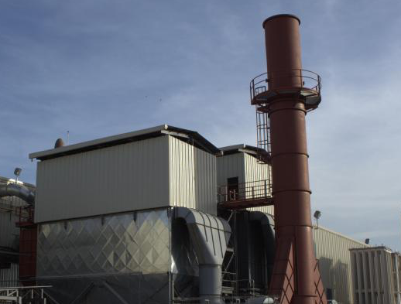
Gas scrubber
Flue gases from furnaces and air from ventilation systems are vented to cyclones, scrubbers, bag houses, etc. for particulate removal.
Flue dust must be removed from the separator (air pollution control equipment) and transported to storage, recycle streams, or to off-plant receivers.
Dust collection systems can be a significant source of lead exposure if not properly operated, cleaned, and maintained.

Slide 45
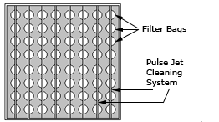
Air filter bag house
“Air Filter Bag House”
Contains 100% polyester Non-woven fabric filter bags fitted in the bag holding cage.
The bag house is equipped with pulse jet type cleaning arrangement.
Pulsejet cleaning unit is designed for continuous operation that operates at appropriate pressure of compressed dry air.

Slide 46
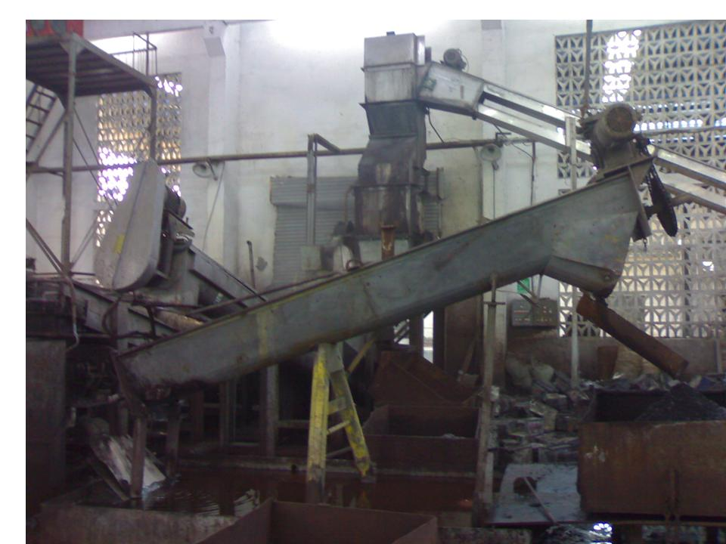
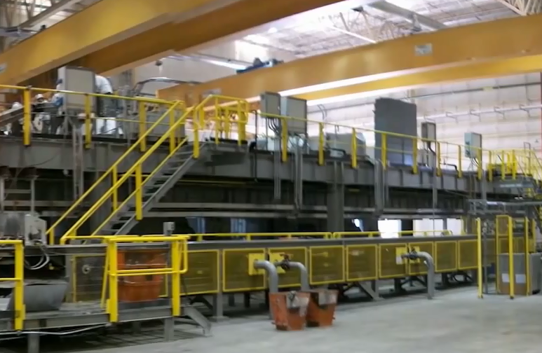
Safe Work Environmental
Others
ventilated process area

Slide 47
Casting Area Environ. Control

Slide 48
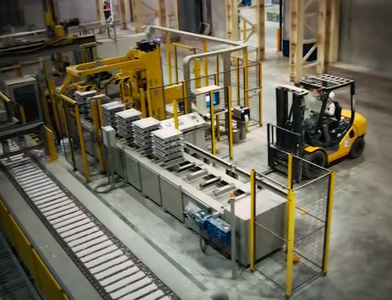
Casting
Refined, or alloyed lead is pumped via heated pipes from kettles to a casting reservoir, or casting wheel, which directs a measured amount of lead into steel or cast iron molds.
Hand operations include drossing and stacking cooled castings.

Slide 49
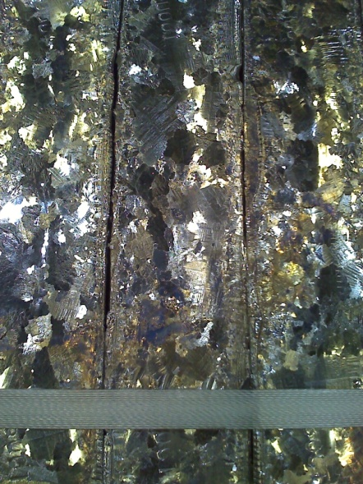
Lead ingots
Elements | Composition in %
Antimony (Sb) | 0.001 (max)
Arsenic (As) | 0.001 (max)
Tin (Sn) | 0.001 (max)
Copper (Cu) | 0.001 (max)
Bismuth (Bi) | 0.030 (max)
Iron (Fe) | 0.001 (max)
Nickel (Ni) | 0.001 (max)
Silver (Ag) | 0.005 (max)
Zinc (Zn) | 0.001 (max)
Calcium (Ca) | 0.0005 (max)
Sulphur (S) | 0.0005 (max)
Aluminum (Al) | 0.0005 (max)
Lead (Pb) | 99.980 (min
Refining Process we churn out Pure Lead Ingots with a minimum purity level of 99.97% by weight that in mostly achieves purity level of 99.985%.

Slide 50
Lab. Environ. Control

Slide 51
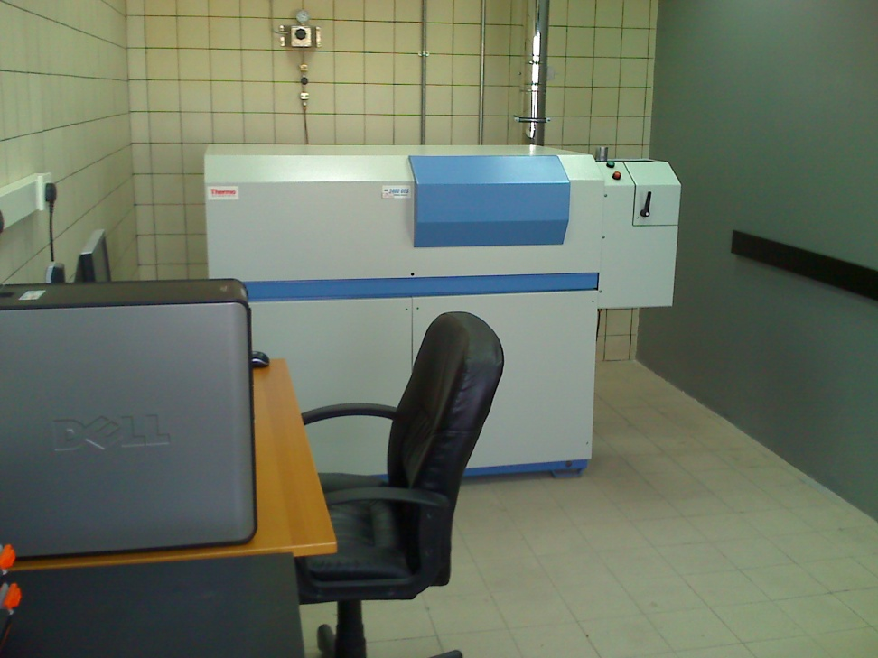
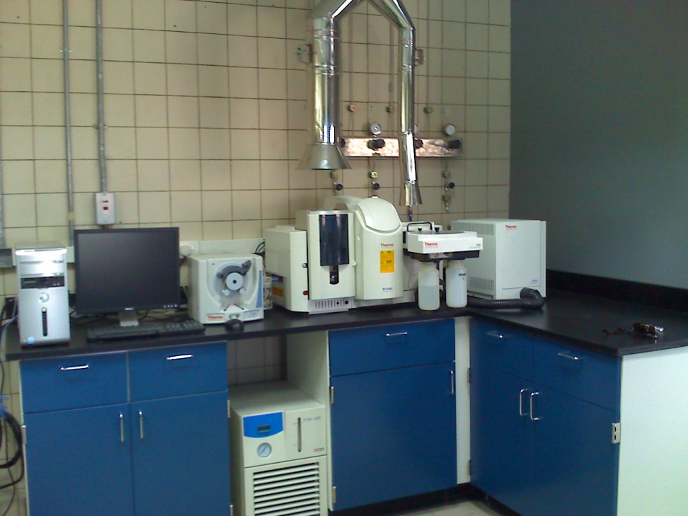
Most Advanced Laboratory
Optical Emission Spectrometer
Atomic Absorption Spectrometer

Slide 52


Most Advanced Laboratory
Air Analyzer
CHNS Analyzer

Slide 53

work practices
Prohibit smoking in the working place;
Segregate the work and eating areas;
Enforce showering at the end of work;
Change out of work clothes before going home;
Change and launder work wear daily;
Check and clean respirators daily.

Slide 54

Conclusion
What would be happened if there is not technology likes?

Slide 55


Old Technology
Environmental Advantages of Battery Recycling by New Technologies:
There is no solid wastes for land filling.
Protection for the following:
  Soil
  Air
  Ground water
  Safety for human health
  Safety for marine
  Safety for animal

Slide 56


Polluted Soil
Damage of environmental quality.
Damage of population health.
Destroy of reuse and recycle as means to
protect non-renewable natural resources.
Damage of a sustainable and regulated system of lead utilization.

Slide 57

Polluted Soil
Lead poisoning does not affect just people, it also affects the environment. The toxic metal is not able to dissolve in water or biodegrade, dissipate, decay, or burn.
This makes lead an extremely harmful hazard.
The lead that gets into the soil ends up staying there for a long time since it does not break down.

Slide 58

Polluted Air
The air will pollute by:-
1- Acid mist, causing acid rain and damage the environment.
Acid rain contains more pH than ordinary.
This is caused by the presence of air pollutants, like sulfur dioxide and nitrogen oxides.
Acid rain is considered as the wet deposits of air pollutants,
2- Lead particles pollution of environment

Slide 59


Polluted Water
Damage of environmental quality.
Damage of population health.
Destroy of reuse and recycle as means to
protect non-renewable natural resources.
Damage of a sustainable and regulated system of lead utilization

Slide 60

Polluted groundwater
Plume is an underground pattern of contaminant concentrations created by the movement of groundwater beneath a contaminant source, with the contaminants spreading in the direction of groundwater movement. The source site has the highest concentration, and the concentration decreases and dissipates away from the source.

Slide 61




Suffering of Some peoples

Slide 62


The results
Mother earth
Environmental Damage

Slide 63
Thanks
Gamal A. Hamid
gamal_a_hamid@hotmail.com

